Slide 1

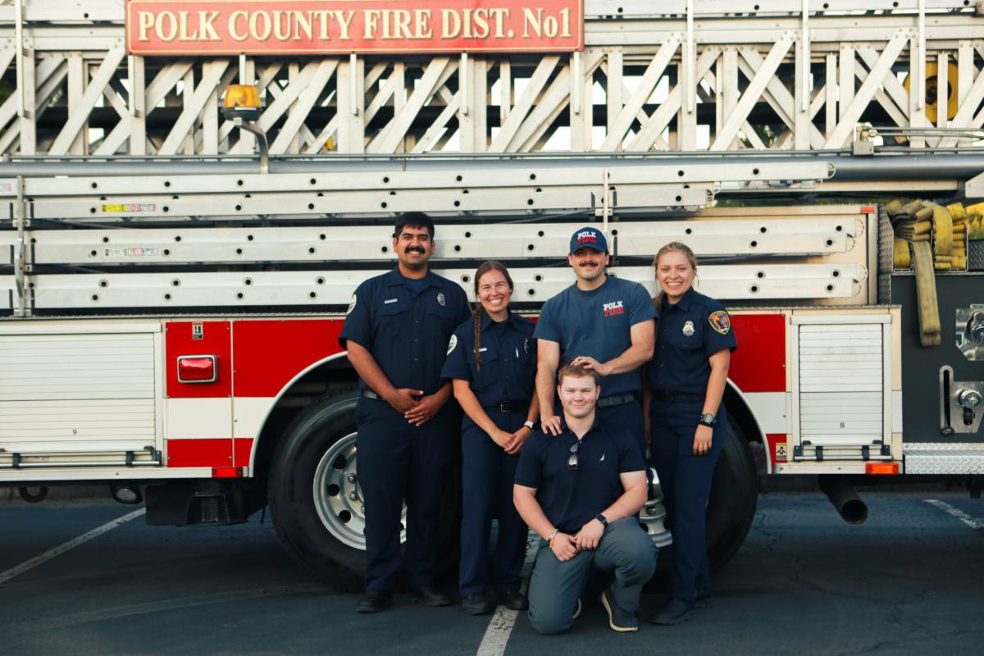
July 2025
Welcome to the Polk County Fire District No.1 newsletter!
Each month, we share updates on fire safety, community outreach, new initiatives, and the hard-working men and women of Polk County Fire District No. 1. Whether you're looking for safety tips, upcoming events, or updates on our services, this newsletter is your go-to source for all things in our district.
Thank you for being a part of our community, and we look

Slide 2
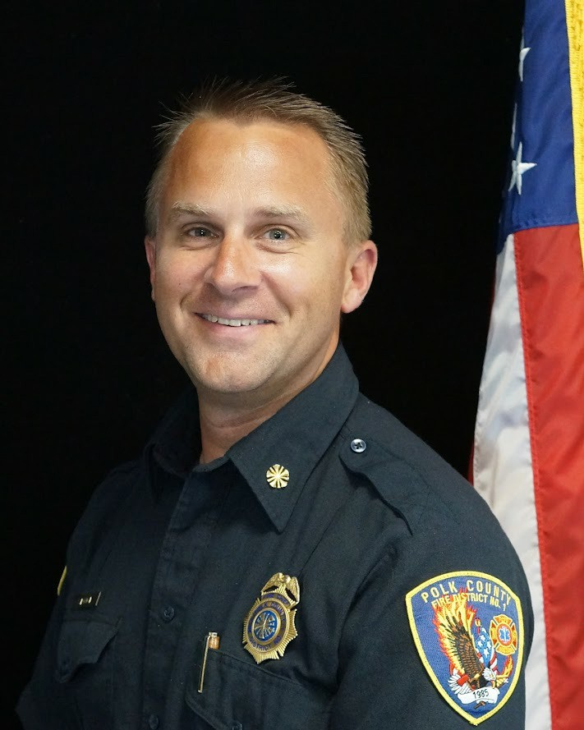
forward to keeping you connected!
Chief's Corner
I’m often asked what a typical day looks like at the fire station.
It sounds like an easy question: “What does a day look like?” I explain that in the fire service, it really depends on the time of year. There is always work to be done, but sometime in June, we transition to taking things day by day. I tell people that, through the summer, even Chief officers are “operationally oriented.” Wednesday, July 9, is a perfect example of this.
When I arrived at work, there was a list
of ongoing tasks needing attention: repairing a drinking fountain, conducting the annual testing of a hose, and managing a flood of emails. The day began predictably. Then, after lunch, we received notification that a conflagration had been declared in Klamath County and a request to assess what resources we could send. While coordinating this through phone calls and texts, a grass fire broke out in our district. We responded to extinguish the fire while also monitoring radio reports of another fire in Marion County that required evacuations.
After extinguishing our fire, we received a request to send resources from our scene to Marion County, which we fulfilled. As we were returning to the station, another request came in—this time from the State—asking for available resources to deploy to Klamath County within one hour. Firefighters prepared their personal items while their colleagues prepped the equipment they would need, simultaneously cleaning up from the fire they had just returned from.
After sending our crew to the Elk Fire in Klamath County, we received another request for assistance in Salem. As we considered the request, we carefully evaluated how much we could reduce our local staffing while still maintaining effective response capabilities in our community. Before the dust had even settled from the afternoon’s actions, we had to begin planning for the fact that it was drill night. Our volunteers would be here from 6:30 to 9:00 pm to work on their skills.
In the summer "operationally oriented” months, we have little say in

Slide 3
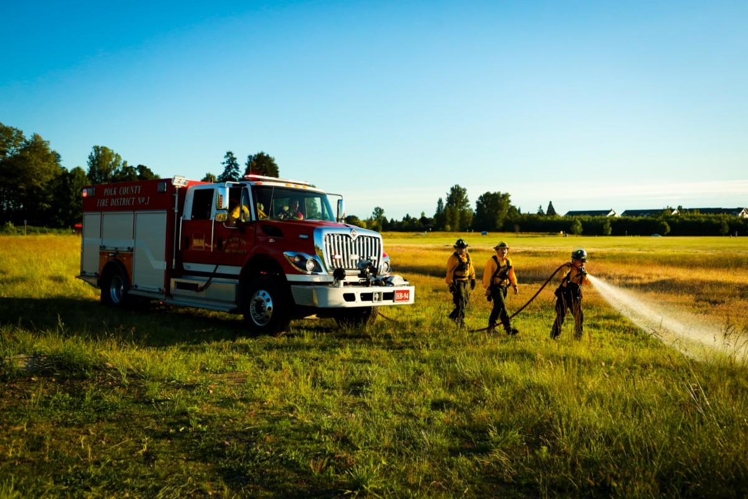
“what a day looks like.” The fire service teaches us to be dynamic, prepared, and decisive. It’s only with a talented group of patient, understanding, and equally dynamic individuals that we can respond and pivot so effectively.
Seasonal Upstaffing Results in Quick Extinguishment of Multiple Vegitation Fires
In anticipation of increased fire risk during the 4th of July festivities, Polk Fire decided to use grant money from the Department of the Oregon State Fire Marshal to add additional staffing during "peak hours" on July 3 and 4. Using these funds, the District managed to staff two "brush rigs" —heavy-duty pickups designed to be effective on vegetation fires with 300 gallons of water, pumps, and hand tools.
On July 3, just after 4:00 pm, units were dispatched to a vegetation fire on Airlie Road outside of Monmouth. Thanks to the combination of the additional staffing along with regular full-time firefighters and volunteers, Polk Fire quickly had two brush rigs, two fire engines, three water tenders, and a command vehicle on scene to quickly stop the fire progression.
On July 4, around 3:00 pm, we received a call for a vegetation fire at Ash Creek Elementary School. Call information included concerns that the fire might be extending up the trees in the forested area. Both brush rigs immediately went alongside the regularly staffed engine, resulting in three units arriving quickly on scene before the fire spread too large.

Slide 4
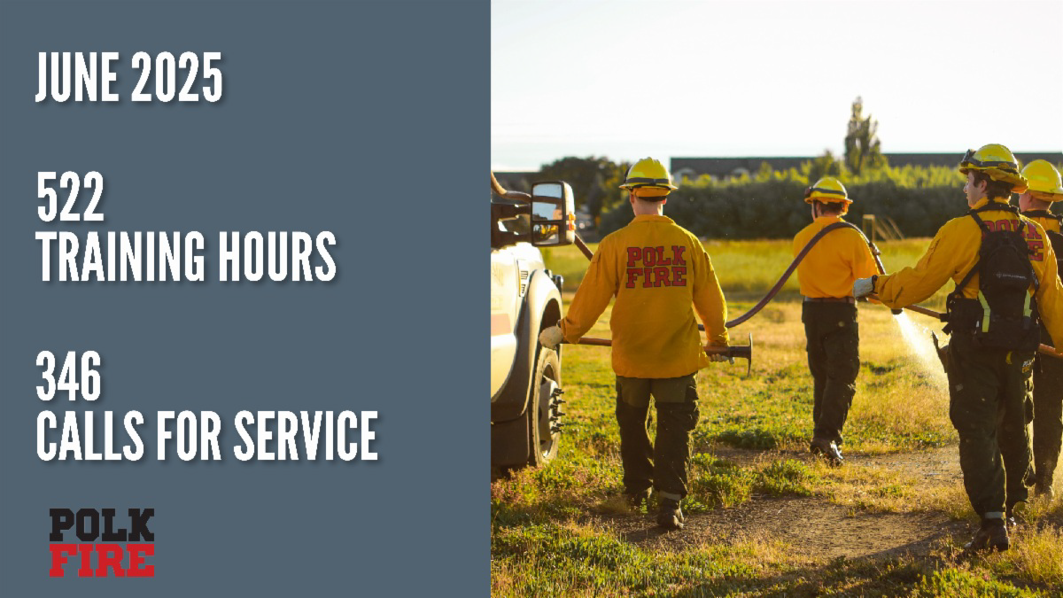
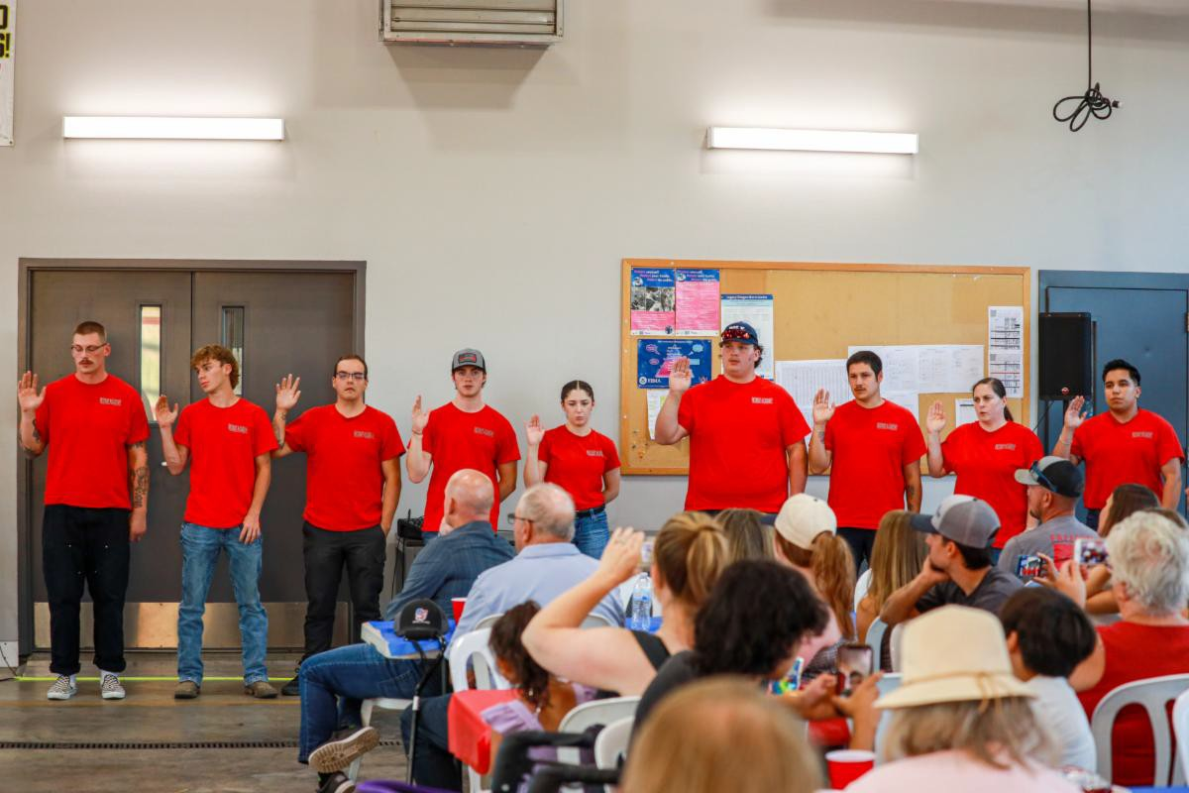
Monthly Stats
Several Firefighters Sworn in as New Members, Others in New Roles
Polk Fire's annual recruit academy wrapped up with ten firefighters individually completing nearly 200 hours of training. The new members were sworn in at a ceremony on July 2nd.
In addition to the new home-responding volunteers, career members

Slide 5
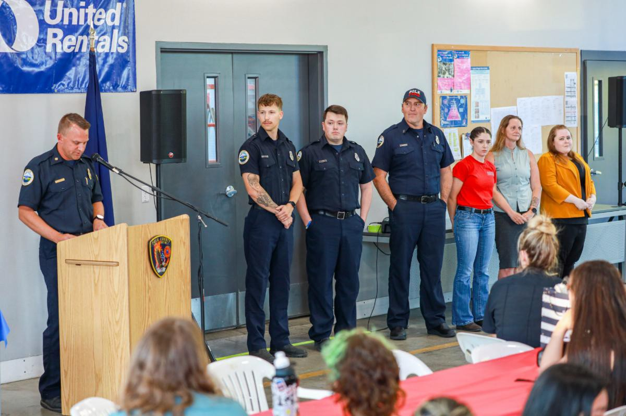
were sworn into their positions as Firefighters and Engineers. Two volunteers were also promoted to the rank of Lieutenant.
The event drew nearly 200 attendees to recognize the responders and their service to our community.
Completing Academy: Dakota Allen Teagen Allen Xander Bailey Joel Caudillo
JJ Chinnock Lane Cole Corban Ibarra Alain Jimenez Sam Schmidgall Hailey Solano
Taking the Oath as Firefighters: Cassidy Worthington
Taking the Oath as Engineers: Stephen Hoem
Jeff Joles Cassidy Watts
Nicholas Wooldridge
Promoted to Lieutenant: Matt Connery Travis Emerling
Lifesaving Teamwork Honored with Challenge Coins
The Lifesaving Challenge Coin is the most important award one can earn in our organization. It is tough to get. Our standard for a life saving challenge coin is that a patient has to have experienced cardiac arrest - meaning their heart stopped, AND they must be discharged from the hospital with good neurological function. This is, admittedly, a high bar, but nothing is a better demonstration of the talent, professionalism, and impact that our responders have. Since we started giving these awards, 46 of our members have received at

Slide 6
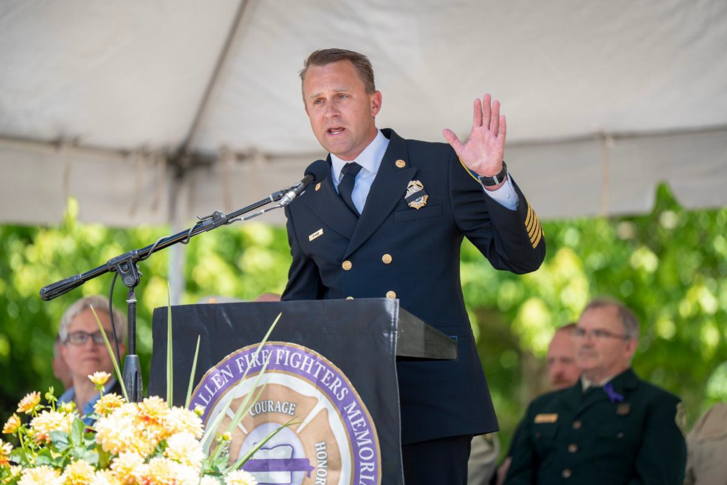
least one.
On July 2nd, we honored Captain Chad Paoli, Engineer Sean McMurry, Engineer Nick Wooldridge, Engineer Jeff Joles, and Firefighter Hailey Solano with their actions on June 22nd that resulted in a save. Having arrived on a patient with no heart beat, their care not only resulted in a return of circulation, but the patient walking out of the hospital and returned home.
We are incredibly grateful to have such a well-trained, intelligent, and cohesive team that can deliver impeccable care in these situations.
Chief Stange Delivers Keynote at Oregon Fallen Firefighter's Memorial
On June 17, Chief Stange served as the keynote speaker at the annual Oregon Fallen Fire Fighters Memorial Ceremony held at the Oregon Public Safety Academy, honoring 182 brave fire service members who have made the ultimate sacrifice since 1881.
The name of Polk County Fire District No.1 Captain Tom Kistler is among those etched on the wall. Chief Stange, having been one of the responders when Captain Kistler died in 2003, reflected on the profound loss and legacy of those who died in service.
“This Wall... these firefighters... they inspire us. Their names are shorthand in our fire stations — symbols of commitment, service, and sacrifice that continue to shape who we are. To the families, your

Slide 7
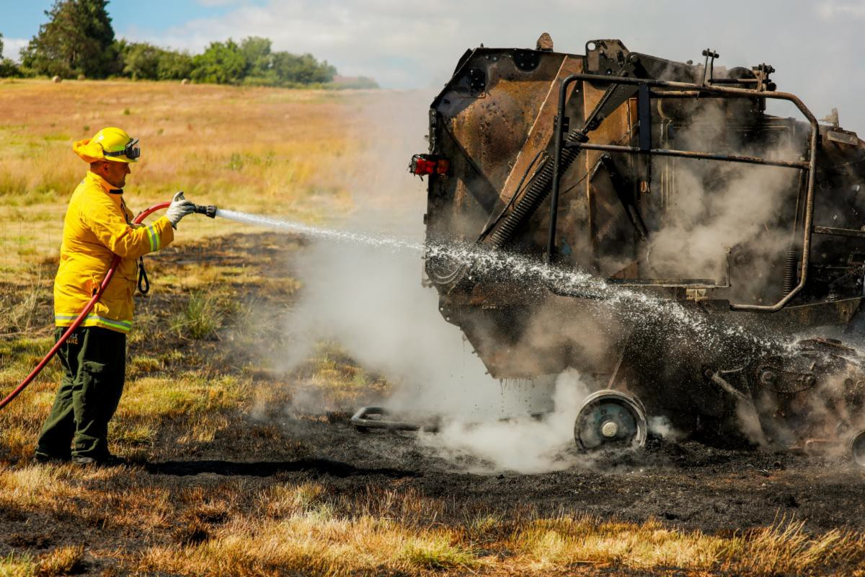
loved ones are forever part of our fire service family. I promise you this, their service, their impact, their inspiration to the fire service, will continue. 22 years later, this I know is true."
Two-Alarm Grass Fire Contained Near Monmouth
On June 18 at around 3:15 PM, crews responded to a two-alarm grass fire that broke out in a one-acre field while it was being baled. Preliminary reports indicate that the baler may have been the cause of the fire, though the exact cause remains under investigation.
Crews arrived on scene quickly and were able to prevent the fire from spreading to a neighboring field that was housing livestock at the time. The fire is now under control, and mop-up operations are expected to continue for the next few hours with assistance from the landowners.
No injuries were reported.
Polk County Fire District No. 1 was assisted on the scene by Falls City Fire, Dallas Fire & EMS, and SW Polk Fire District.
Polk Fire Recognized as a "Peds Ready EMS Agency"
Polk Fire has been recognized by the

Slide 8

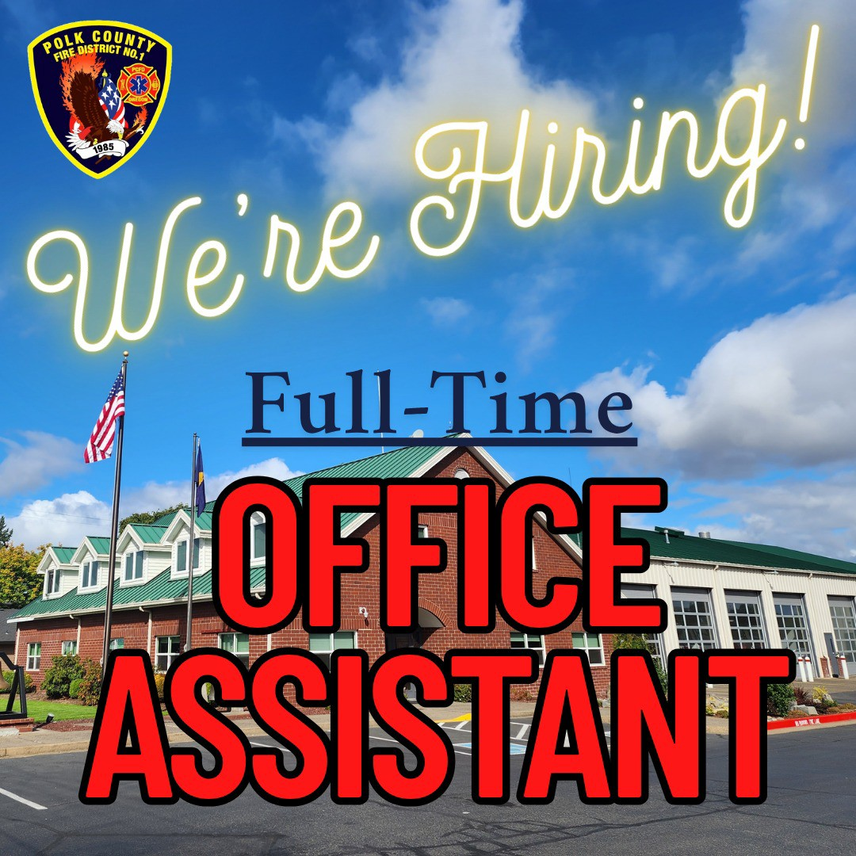
Emergency Medical Services for Children Program as one of the first 20 ambulance agencies in Oregon to be a "Peds Ready EMS agency."
The designation recognizes our
of and
dedication to the pediatric emergency
provision medical
trauma care in our community.
We're Hiring!
Polk County Fire District No.1 is seeking a friendly, detail-oriented individual to join our team. This is an incredible opportunity to be a part of an organization with a lasting impact on the daily lives of those in our community.

Slide 9

The Office Assistant is tasked with performing routine clerical work to our staff and members of the public. The schedule is 32 – 40 hours per week. In addition, the Office Assistant participates in evening meetings that typically occur once a month.
Application, cover letter, resume, and letters of reference (optional) must be received by 5:00 pm on Friday, July 25, 2025.
Learn More and Apply Here
Serving Polk County
1800 Monmouth St.
Independence, OR 97351
(503) 838-1510
Polk County Fire District No. 1 | 1800 Monmouth St. | Independence, OR 97351 US
Unsubscribe | Update Profile | Constant Contact Data Notice

