Slide 1
Polk County
Fire District No.1
Board Meeting
January 13, 2022

Slide 2
CALL MEETING TO ORDER: Anyone wishing to address the Board please use the hand raise feature on Zoom if possible and if not feel free to come off mute.
PLEDGE OF ALLEGIANCE: Due to this being a virtual meeting, we will be deferring the pledge this month.
Meeting Minutes will be recorded and kept for 60 months.
OPEN FOR PUBLIC COMMENT ON ANY OF THE AGENDA ITEMS: If you would like to comment, please use the hand raise feature or come off mute.
CONSENT AGENDA
  1. Board Agenda
  2. Approve December 9, 2021 Regular Board Meeting Minutes
  3. Financials:
    3a. Approval of Disbursements for December 1-31, 2021
    3b. Financial report for the month of December 2021

Slide 3
Unfinished Business
a) COVID-19 Update and Impacts
b) ODF Boundary Change
c) Ambulance Rate Increase (Resolution 2022-01)

Slide 4
COVID-19 Update and Impacts

Slide 5
Since Saturday
Both weekend actives at the station had at least one individual who became symptomatic and tested positive for COVID
Multiple volunteers who themselves or families are ill
Three out of the four chief officers have had fevers above 100 degrees
Two line-staff are returning from COVID leave and now three are symptomatic and positive and are on leave
Had one volunteer hospitalized for nearly a week (was hopeful to get out today)
Decided to shut down all in person non-response related activities for this week
This was a result of the immediate impacts on our agency
Will move forward with a drill Saturday dependent upon negative testing

Slide 6
New SOG on Workplace Exclusion
The CDC has provided a continuum of options for work exclusion for healthcare providers. The continuum was created in acknowledgement that agencies (hospitals, care homes, EMS, etc) must continue to function even in a times of widespread sickness. The steps include conventional, contingency, and crisis response. The expectation is that the strategies are used and considered sequentially (implementing contingency strategies before crisis strategies). The District has adopted the CDC guidance to provide a framework for our work and response exclusions.
https://www.cdc.gov/coronavirus/2019-ncov/hcp/mitigating-staff-shortages.html

Slide 7
WORKPLACE RESTRICTIONS:
CONVENTIONAL
  With positive COVID-19 test:
    Boosted and no boosted: May return 10 days after initial positive test or onset of symptoms (if asymptomatic, mild, or improving symptoms)
  Exposure to COVID-19 with no symptoms:
    Boosted: No work restrictions. Try and provide test at day 2, & 5-7
    Not boosted: 10 days work restriction, or 7 days with negative test
CONTIGENCY
  With positive COVID-19 test:
    Boosted and no boosted: May return 5 days after initial positive test or onset of symptoms (if asymptomatic, mild, or improving symptoms)
  Exposure to COVID-19 with no symptoms:
    Boosted: No work restrictions
    Not boosted: No work restrictions, test if possible on days 1, 2, 3, & 5-7
CRISIS
  With positive COVID-19 test:
    Boosted and no boosted: No work restrictions if asymptomatic or only mildly symptomatic
  Exposure to COVID-19 with no symptoms:
    Boosted: No work restrictions
    Not boosted: No work restrictions

Slide 8
RETURNING TO WORK OR RESPONSE:
Once the outlined time requirements have been met, an individual must be at least 24 hours without a fever (100.0) without the use of fever-reducing medications and must have improving symptoms.
When returning to work or response, anyone who has been away due to exposure must wear an N95 or KN95 at all times (except when sleeping or eating) for 10 days following their initial symptoms or positive test.

Slide 9
Notes:
*The day of a positive test or symptom onset is considered day 0.
**Negative COVID tests are not necessary. According to the CDC, “Patients who have recovered from COVID-19 can continue to have detectable SARS-CoV-2 RNA in upper respiratory specimens for up to 3 months after illness onset. However, replication-competent virus has not been reliably recovered and infectiousness is unlikely.”
***A person who has tested positive within the past 90 days will be considered to be “vaccinated” for the sake of workplace exclusion.

Slide 10
Unfinished Business
a) COVID-19 Update and Impacts
b) ODF Boundary Change
c) Ambulance Rate Increase (Resolution 2022-01)

Slide 11
ODF Boundary Change
Welcome Jeff Classen and Ted Erdmann from ODF

Slide 12
Unfinished Business
a) COVID-19 Update and Impacts
b) ODF Boundary Change
c) Ambulance Rate Increase (Resolution 2022-01)

Slide 13
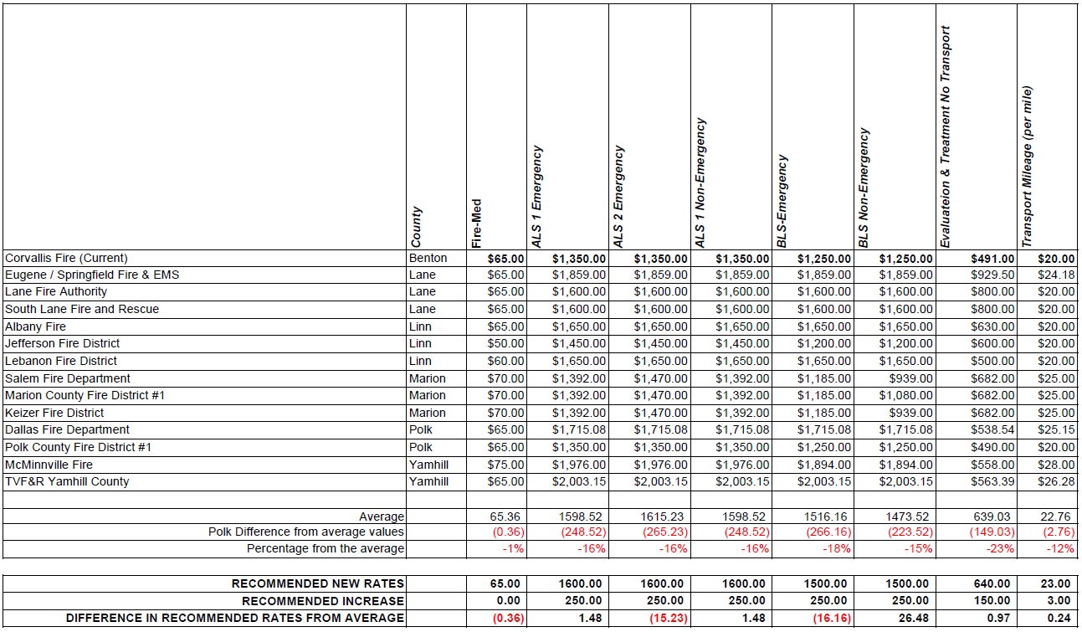

Slide 14
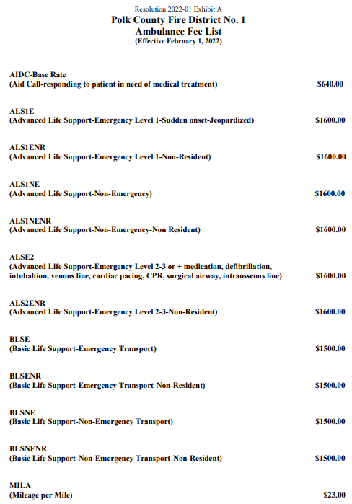

Slide 15
Ambulance Rate Increase
(Resolution 2022-21)
WHEREAS, the Board of Directors of Polk County Fire District No. 1 is charged with the responsibility of rates for ambulance; and
WHEREAS, it is the desire of the Board of Directors to maintain rates which are consistent with operating expenses of the District’s ambulance service; and
WHEREAS, it is prudent to keep the cost of District’s ambulance service consistent with other services in our area; and
NOW THEREFORE BE IT RESOLVED that the Board of Directors of Polk County Fire District No.1 hereby adopts the listed Ambulance Base Rate Schedule “Exhibit A”.
BE IT FURTHER RESOLVED that the rates become effective February 1, 2022.
APPROVED by the Board of Directors this January 13th, 2022.

Slide 16
New Business
a) Station 90 Window Replacements (Budget Item 7090r)
b) Purchase of new EZ Load Gurney (Budget Item E-7058)
c) Purchase of new Cardiac Monitors (Budget Item E-7089)
d) Purchase of new mCPR Devices (Budget Item E-7090)
e) Purchase of new Ambulance (Budget Item E-7056)
f) Apparatus Replacement Planning

Slide 17
Station 90 Window Replacements
(Budget Item 7090r)
Currently original wood windows from construction in 1992
Not energy efficient and have some rotting
Upstairs windows have already been replaced
Budgeted $18,000 prior to large price increases
Will cost $25,000
Will absorb increase in deferring other purchases from Capital Outlay
Article 13, Section 13.6 requires I inform the Board prior to purchases over $20,000. Because it is less than $100,000 it does not require Board action
I will be signing a contract with A Hammer Above for $24,800

Slide 18
New Business
a) Station 90 Window Replacements (Budget Item 7090r)
b) Purchase of new EZ Load Gurney (Budget Item E-7058)
c) Purchase of new Cardiac Monitors (Budget Item E-7089)
d) Purchase of new mCPR Devices (Budget Item E-7090)
e) Purchase of new Ambulance (Budget Item E-7056)
f) Apparatus Replacement Planning

Slide 19
Purchase of new EZ Load Gurney
(Budget Item E-7058)
We own three gurneys, two over 13 years old
The two old ones are beyond the typical lifespan based on age and usage
We budgeted to spend $18,000 on a replacement
We will be moving forward with purchasing a replacement for $16,789.53

Slide 20
New Business
a) Station 90 Window Replacements (Budget Item 7090r)
b) Purchase of new EZ Load Gurney (Budget Item E-7058)
c) Purchase of new Cardiac Monitors (Budget Item E-7089)
d) Purchase of new mCPR Devices (Budget Item E-7090)
e) Purchase of new Ambulance (Budget Item E-7056)
f) Apparatus Replacement Planning

Slide 21
Purchase of new Cardiac Monitors
(Budget Item E-7089)
District owns 5 monitors and budgeted to replace 3 for $90,000
Decided after reaching out to vendors to attempt to replace 4 and not keeping a 5th
EMS Committee evaluated monitors
Recommended the District spend $90,858.39 (after trade ins and credits) in order to purchase four Lifepack monitors from Stryker
Article 13, Section 13.6 requires I inform the Board prior to purchases over $20,000. Because it is less than $100,000 it does not require Board action
I will be spending $90,858.39 to purchase four Lifepack monitors from Stryker

Slide 22
New Business
a) Station 90 Window Replacements (Budget Item 7090r)
b) Purchase of new EZ Load Gurney (Budget Item E-7058)
c) Purchase of new Cardiac Monitors (Budget Item E-7089)
d) Purchase of new mCPR Devices (Budget Item E-7090)
e) Purchase of new Ambulance (Budget Item E-7056)
f) Apparatus Replacement Planning

Slide 23
Purchase of new mCPR Devices
(Budget Item E-7090)
Mechanical CPR (mCPR) devices are becoming an industry standard
We budgeted $50,000 in order to purchase three, one for each ambulance
The EMS Committee evaluated three different mCPR devices and recommended the purchase of three Lucas devices by Stryker
Article 13, Section 13.6 requires I inform the Board prior to purchases over $20,000. Because it is less than $100,000 it does not require Board action
I will be spending $43,043.02 to purchase three Lucas mCPR devices from Stryker

Slide 24
New Business
a) Station 90 Window Replacements (Budget Item 7090r)
b) Purchase of new EZ Load Gurney (Budget Item E-7058)
c) Purchase of new Cardiac Monitors (Budget Item E-7089)
d) Purchase of new mCPR Devices (Budget Item E-7090)
e) Purchase of new Ambulance (Budget Item E-7056)
f) Apparatus Replacement Planning

Slide 25
Purchase of new Ambulance
(Budget Item E-7056)
We have budgeted $240,000 to replace one of our ambulance
The patient compartment on one being replaced initially purchased in 2006
Has been mounted on two different International chassis
Last two ambulance purchases (Ford F-550) have worked very well
We intend to purchase a new ambulance which will include a new patient compartment as well as a new Ford F-550 chassis
Chief Mayfield has been working with four vendors, Road Rescue, Brawn NW, Lifeline, and Horton
Some of the specifications included in the bids we requested were items such as powerload gurney wiring, a Knox Medvault, non-fabric front seats, a 360 exterior camera system, and liquid spring suspension

Slide 26
Purchase of new Ambulance
(Budget Item E-7056)
The total with tax, additions, and pre-payment discounts are as follows:
Road Rescue: $207,867
Horton: $242.505
Braun NW: $259,440
Lifeline: $264,345

Slide 27
Purchase of new Ambulance
(Budget Item E-7056)
It is the opinion of myself and Chief Mayfield that the District proceed with the purchase of this ambulance through Horton. Although a couple thousand dollars above the budgeted amount, other expenditures in the Reserve Fund will fall under budget and no adjustments will be needed.
As per Article 13: Administrative Policy, Section 13.6, budgeted purchases over $100,000 require Board approval.
Options:
1. Ask staff to report back in order to respond to specific questions the Board has.
2. Approve the expenditure of $242,505 to purchase a new ambulance from Horton.
Recommendation: Staff recommends option 2.
Motion: “I recommend that we approve the expenditure of $242.505 for the purchase of a new ambulance through Horton.”

Slide 28
New Business
a) Station 90 Window Replacements (Budget Item 7090r)
b) Purchase of new EZ Load Gurney (Budget Item E-7058)
c) Purchase of new Cardiac Monitors (Budget Item E-7089)
d) Purchase of new mCPR Devices (Budget Item E-7090)
e) Purchase of new Ambulance (Budget Item E-7056)
f) Apparatus Replacement Planning

Slide 29
TOPICS
Items purchased through the Reserve Fund
History of Purchases – Current age of Fleet
Short, medium, and long term priorities

Slide 30
Items Purchased through the
Reserve Fund
Engines
  We own two Type 1 commercial engines, and three Type 1 interface engines
Water Tenders
  We own four water tenders
Brush Rigs
  We own 2 Type 6 brush vehicles
Other Fire Apparatus
  We own a heavy rescue and a ladder truck
Ambulances
  We own three ambulances

Slide 31
Items Purchased through the
Reserve Fund (cont)
Other vehicles
  We own eight other vehicles, some that won’t be replaced (D-91, C-90, C-95, FM-91, a van, a pickup, an unmarked Prius, and a support vehicle used at Station 70 in Pedee)
Radios
  We own 65 portable radios
Airpacks
  We own 44 airpacks
Gurneys
  Each of the three ambulances has an electric gurney
Heart Monitors
  Each of the three ambulances and the first out engine at Station 90 have heart monitors
mCPR Devices
  We are budgeted to purchase our first ever mCPR devices this year

Slide 32
History of Purchases –
Current age of Fleet
Engines
  Four of our five engines were purchased in 2015, the other engine was purchased in 2008
Water Tenders
  Two of the tenders were purchased in 2012, another was purchased in 2015, and the oldest was purchased in 1988
Brush Rigs
  One was purchased in 2008, the other in 2019
Other Fire Apparatus
  Our heavy rescue was purchased in 1999 and our ladder truck was purchased in 2002
Ambulances
  Our ambulances are 2017, 2019, and 2008 (budgeted for replacement this FY)

Slide 33
History of Purchases –
Current age of Fleet
Other vehicles
  D-91: 2011, C-90: 2015, C-95: 2015, FM-91: 1999, Van: 2008, Pickup:1998, Unmarked:2017 , S-71: 1996
Radios
  All were purchased in 2016
Airpacks
  All were purchased in 2016
Gurneys
  Two are 13 years old (one budgeted to be replaced this year) the other is 2017
Heart Monitors
  All are over 10 years old (budgeted to be replaced this year)
mCPR Devices
  We are budgeted to purchase our first ever mCPR devices this year

Slide 34
Short Term Priorities
0 – 5 Years
Need has been established
Exact year of purchases may shift by a year or two
Funding strategy determined

Slide 35
Short Term Priorities
This Fiscal Year
  Heart monitors, mCPR devices, gurney, and new ambulance
An additional ambulance will need to be purchased (likely around FY 2024-25)
  This purchase will include a new gurney if it has not already been done
Radios
  As radio systems change to P-25 we will engage with neighboring agencies to pursue a grant
  If a grant is unsuccessful, we expect the purchase will need to be made around FY 2025-26
Staff Vehicles
  A new Duty rig will be purchased trickling down into the fleet
All of these purchases will be made through direct spending from the Reserve Fund or successful grants

Slide 36
Medium Term Priorities
6-10 Years
Plans on replacement are flexible and may change with usage and technology
For PCFD, medium term includes the completion of our bond debt servicing in 2029

Slide 37
Medium Term Priorities
An additional ambulance will need to be purchased
Some staff vehicles will be replaced
Three significant purchases will need to be made:
  A commercial engine to replace the 2008 Crimson (used as first out at Station 90)
  The ladder truck will pass 25 years of age
  Our airpacks will need to be replaced
In FY 2029-30 we will have completed payments on our current GO bond. A reasonable option would be to move forward with a bond to fund these purchases. At this point, I would suspect this would be around a $ 2.5M bond that could be 10 years. Although we do not know what the value of the District will be or what interest rates will be like, this could be a cost of around .10 - .15 cents per thousand for tax payers.

Slide 38
Long Term Priorities
All of the routine replacement items will continue to happen from direct expenditures from the Fund as well as through grant applications
  Ambulances, staff vehicles, radios, heart monitors, etc.
The next large fleet replacement would be possible to do when the previous 10 year 2029-30 bond is paid off in 2039-40.
  At that point, the fleet that was purchased in 2015 (and tenders from 2012) will be 25-28 years old.
  This includes four engines and three water tenders (it is possible that not all engines get replaced with Type 1 engines)

Slide 39
Questions

Slide 40
Chief’s Report
a) Review of certifications received in 2021
b) Holiday Party
c) Fitness Improvement Team
d) Upcoming academy
e) Notable incidents
f) Member of the month

Slide 41
TOPICS FOLLOWING THE PREPARATION OF THE AGENDA
PUBLIC COMMENTS (please raise your hand or take yourself off mute)
BOARD MEMBER COMMENTS
EXECUTIVE SESSION: According to ORS 192.660 If necessitated by business. None Anticipated.
ADJOURNMENT

